Slide 1
Networking Demo
Christopher Martin
Notes:
Hi, my name is Chris Martin and this is my Networking Demo on

Slide 2

XYZ Travel Agency
Small Network Implementation
Network Security
Active Directory
User Control and Filesharing
Notes:
The xyz travel agency, where we will briefly cover, small network implementation, network security, active directory, user control and filesharing.

Slide 3
Scenario:
The owner of XYZ Travel Agency has been reading the news lately of various cybersecurity incidents around the country. His agency currently has dozens of staff connected to a workgroup with no central file share, no monitoring and no user management. Since he has become concerned about cybersecurity, he has asked us to harden the network and monitor it for security.
The plan for improving this network is as follows:
Create a new network with firewalls, servers and clients.
Implement a redundant Opnsense firewall with backup features.
Implement Active Directory to help manage users and to create a place to share data/information.
Harden the network and user accounts for security.

Slide 4
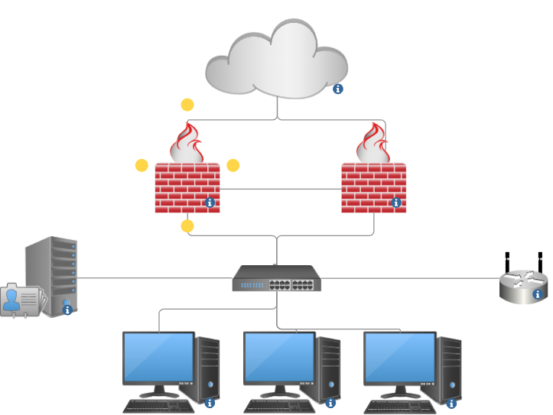
Network Topography
Notes:
Here we have an image of the network topography with two-firewalls, local switch, server running active directory and client computers.

Slide 5

The Firewall:
OpnSense is an open-sourced firewall with many advanced security features. I downloaded a plug-in called Zenarmor to provide a range of extra security features including proxy controls.
The firewall serves as the first defense for the network operating between the WAN (Internet) and the local network.
Primary concern with this network was to have two firewalls in case one should fail.
This Photo by Unknown Author is licensed under CC BY-SA

Slide 6
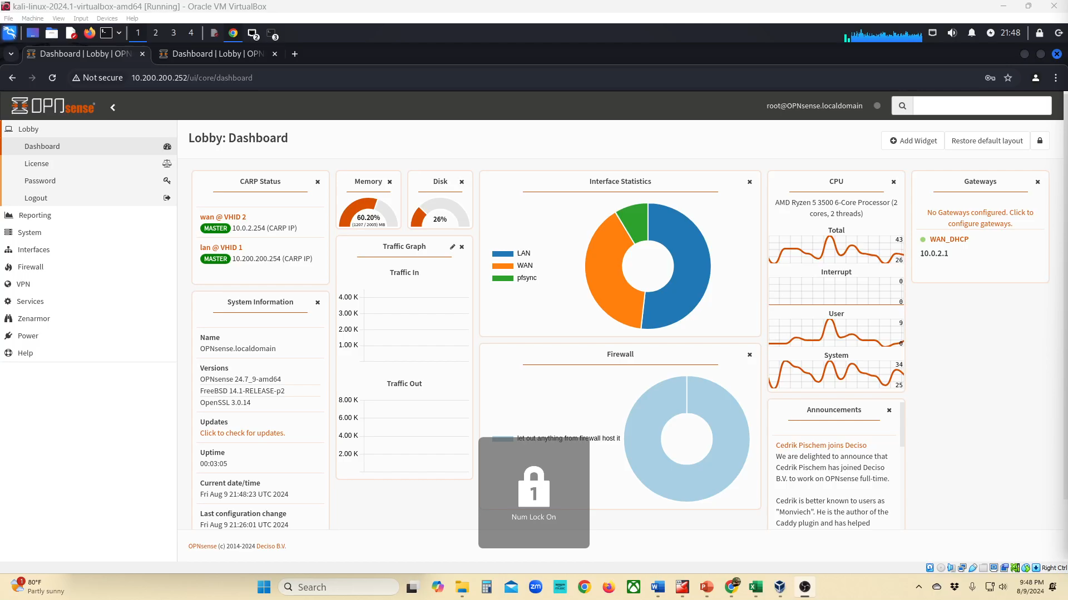

Slide 7
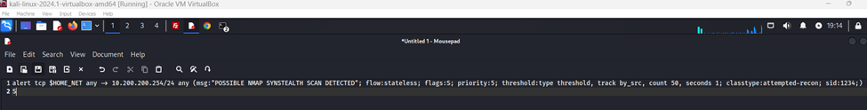
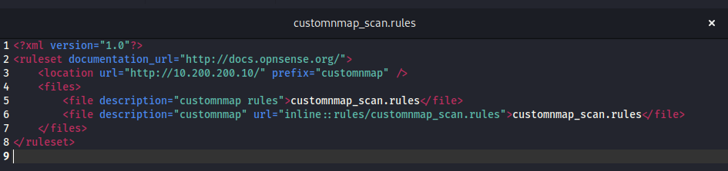
Example of Firewall Security
In the firewall I started the intrusion detection service and wrote a custom rule to detect a simple Nmap scan, should one occur against the network.

Slide 8
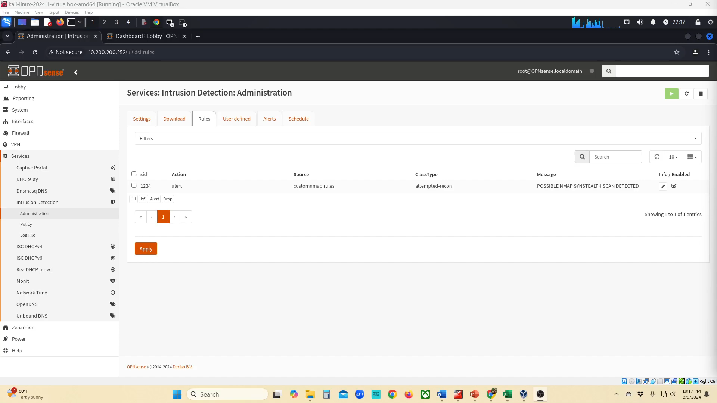

Slide 9
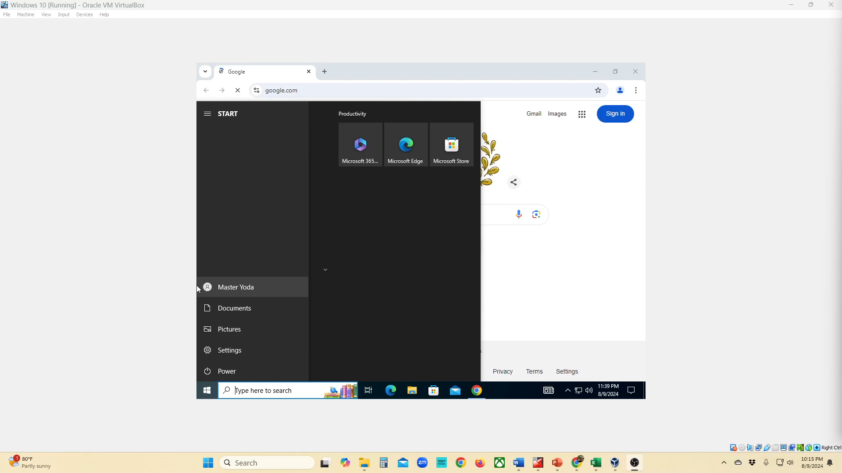
Firewall: proxy controls to manage access

Slide 10
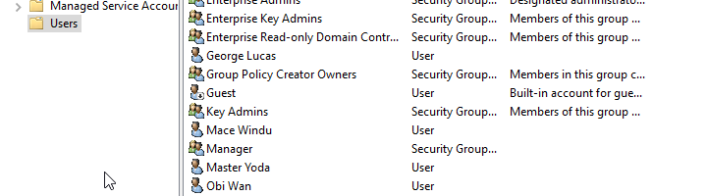
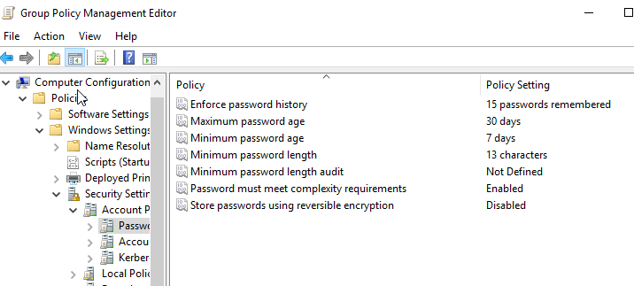
Active directory
Active directory running on Windows Server 2019 plays a pivotal role in centralizing employee management and creating a way for employees to collaborate information on a shared space locally rather than resorting to cloud services.
It allowed for me to group users together, providing an easy way to set permissions and create GPO’s.
Next, we’ll take brief look at how filesharing worked and how it was secured.

Slide 11
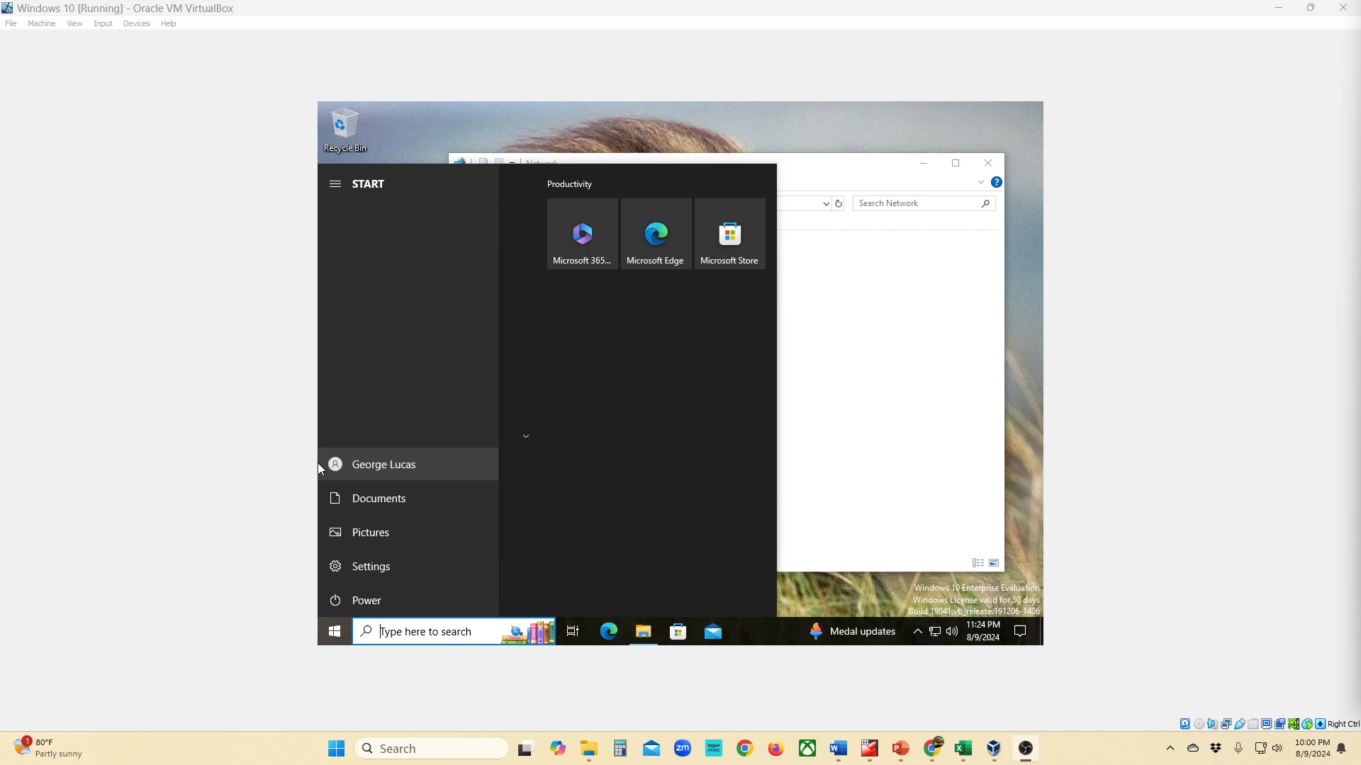

Slide 12
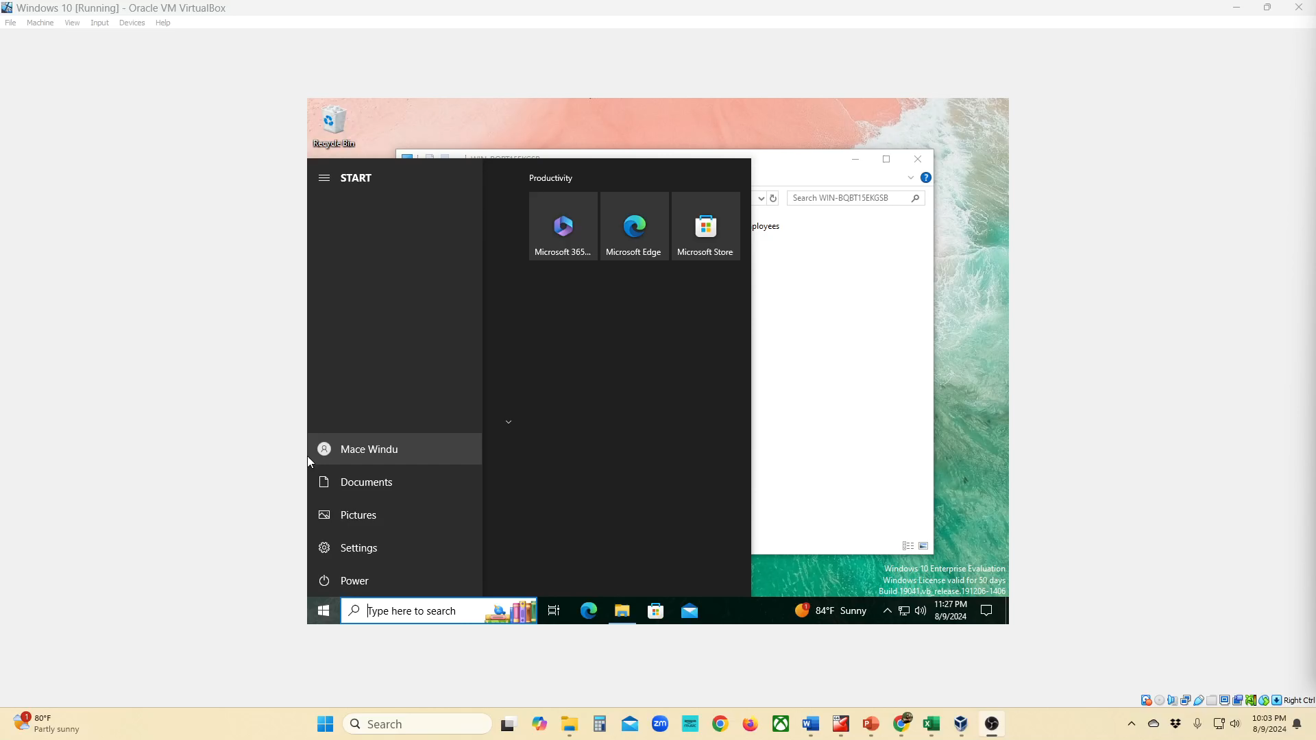

Slide 13
Conclusion
Although brief, this short demo showed how we met most of the demands that the owner of XYZ travel agency wanted for his network.
We gave him a quicker way to manage user accounts including requiring complex passwords and setting up audit logs, provided a hardened firewall with a backup, set up some intrusion detection rules, and provided a secure way to share files.

Slide 14
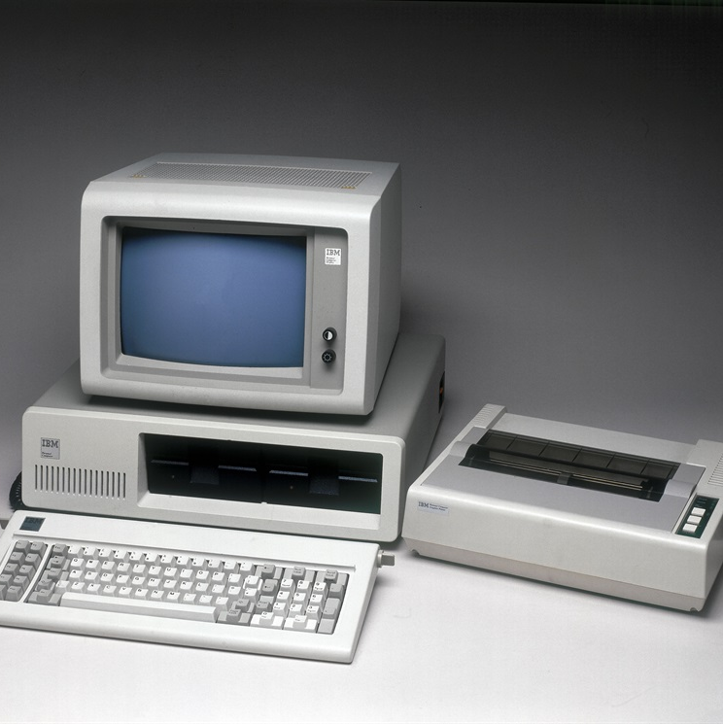
Thank you
Christopher Martin
ittechytime@outlook.com
www.linkedin.com/crmartin91
This Photo by Unknown Author is licensed under CC BY-SA

